Slide 1
NoSQL
Yasin N. Silva
Arizona State University
This work is licensed under a Creative Commons Attribution-NonCommercial-ShareAlike 4.0 International License. See http://creativecommons.org/licenses/by-nc-sa/4.0/ for details.

Slide 2
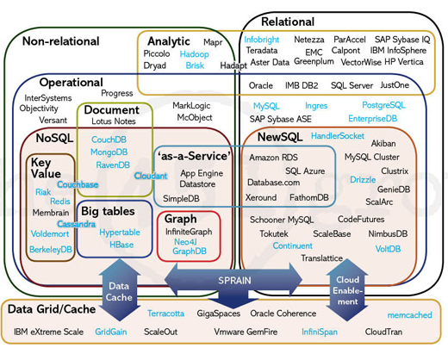
The Big Picture
http://blogs.the451group.com/opensource/2011/04/15/nosql-newsql-and-beyond-the-answer-to-sprained-relational-databases/

Slide 3
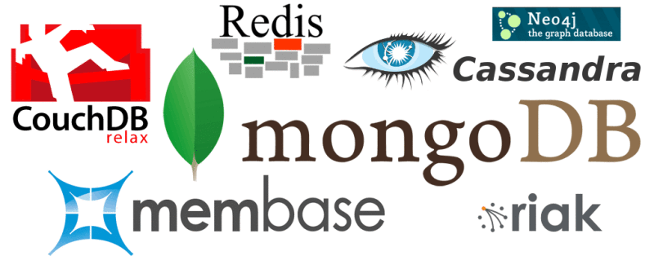
NoSQL
NoSQL = Not only SQL
Broad class of database management systems
  Non-adherence to the relational database model
  Generally do not use SQL for data manipulation

Slide 4
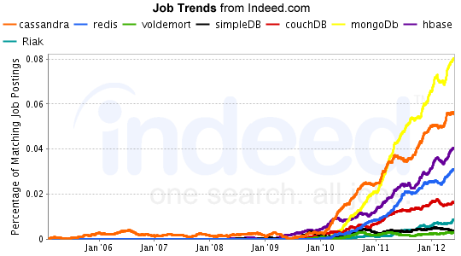
NoSQL Job Trends
http://www.indeed.com/jobanalytics/jobtrends?q=cassandra,+redis,+voldemort,+simpleDB,+couchDB,+mongoDb,+hbase,+Riak&l=

Slide 5
Why NoSQL?
Relational databases cannot cope with massive amounts of data (like datasets at Google, Amazon, Facebook, etc.)
Many application scenarios don’t use a fixed schema.
Many applications don’t require full ACID guarantees.
NoSQL database systems are able to manage large volumes of data that do not necessarily have a fixed schema.
NoSQL databases do not necessarily provide full ACID guarantees. They commonly provide eventual consistency.
When should we use NoSQL?
  When we need to manage large amounts of data, and
  Performance and real-time nature is more important than consistency
    Indexing a large number of documents
    Serving pages on high-traffic web sites
    Delivering streaming media

Slide 6
Key Properties of NoSQL Databases
NoSQL usually has a distributed, fault-tolerant architecture.
Data is partitioned among different machines
  Performance
  Size limitations
Data is replicated
  Tolerates failures
Can easily scale out by adding more machines
NoSQL databases commonly provide eventual consistency
  Given a sufficiently long period of time over which no changes are sent, all updates can be expected to propagate eventually through the system

Slide 7
Taxonomy of NoSQL Databases 1/2
Document store
  Store documents that contain data in some format (XML, JSON, binary, etc.)
  Examples: MongoDB, SimpleDB, CouchDB, Oracle NoSQL Database, etc.
Key-Value store
  Store the data in a schema-less way (commonly key-value pairs). Data items could be stored in a data type of a programming language or an object.
  Examples: Cassandra, Dynamo, Riak, MemcacheDB, etc.
Graph databases
  Stores graph data. For instance: social relations, public transport links, road maps or network topologies.
  Examples: AllegroGraph, InfiniteGraph, Neo4j, OrientDB, etc.

Slide 8
Taxonomy of NoSQL Databases 2/2
Tabular
  Examples: Hbase, BigTable, Hypertable, etc.
Object databases
  Examples: db4o, ObjectDB, Objectivity/DB, ObjectStore, etc.
Others: Multivalue databases, RDF databases, etc.

Slide 9

HBase
http://hbase.apache.org/

Slide 10

HBase
HBase is an open source NoSQL distributed database
Modeled after Google's BigTable and written in Java
Runs on top of HDFS (Hadoop Distributed File System)
Provides a fault-tolerant way of storing large amounts of sparse data
Provides random reads and writes (HDFS does not support random writes)

Slide 11






Who uses HBase?
Adobe
Facebook
Meetup
Stumbleupon
Twitter
Yahoo!
and many more…

Slide 12

Hbase Features
HBase is not ACID compliant
  However, it guarantees certain properties, e.g., all mutations are atomic within a row.
Strongly consistent reads/writes
  HBase is not an "eventually consistent" DataStore. This makes it very suitable for tasks such as high-speed counter aggregation.
Automatic sharding
  HBase tables are distributed on the cluster via regions, and regions are automatically split and re-distributed as your data grows
Automatic RegionServer failover
Hadoop/HDFS Integration
  HBase supports HDFS out of the box as its distributed file system
MapReduce
  HBase supports massively parallelized processing via MapReduce for using HBase as both source and sink
Java Client API
  HBase supports an easy to use Java API for programmatic access.
Block Cache and Bloom Filters
  HBase supports a Block Cache and Bloom Filters for high volume query optimization
Operational Management
  HBase provides build-in web-pages for operational insight as well as JMX metrics.
Apache HBase Reference Guide: http://hbase.apache.org/book/architecture.html#arch.overview

Slide 13
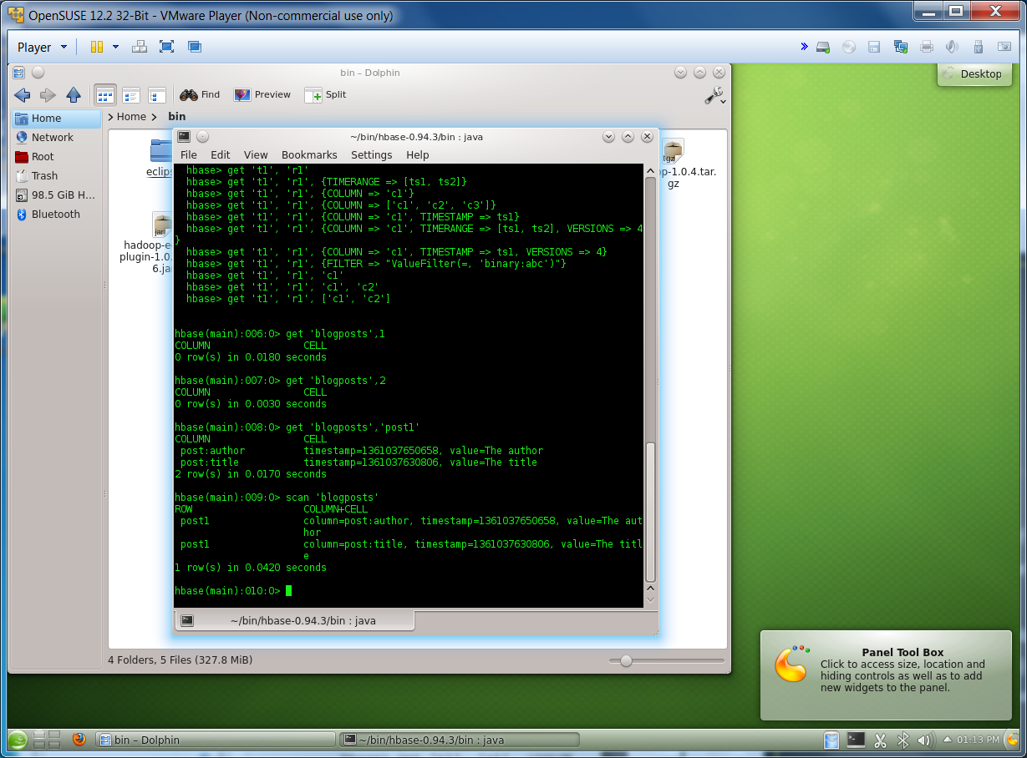
HBase: Shell (Using Class VM)
Initial Steps
  Already done in our class VM
    Download Hbase and unpack it, for instance to ~/bin/hbase-0.94.3
    Edit ~/bin/hbase-0.94.3/conf/hbase-env.sh and set JAVA_HOME
  cd ~/bin/hbase-0.94.3/bin/
  Start hbase by running: ./start-hbase.sh
  Start the HBase shell by running: ./hbase shell
Create a table
  Run: create 'blogposts', 'post', 'image'
Adding data to the table
  put 'blogposts', 'post1', 'post:title', 'The Title'
  put 'blogposts', 'post1', 'post:author', 'The Author'
  put 'blogposts', 'post1', 'post:body', 'Body of a blog post'
  put 'blogposts', 'post1', 'image:header', 'image1.jpg'
  put 'blogposts', 'post1', 'image:bodyimage', 'image2.jpg'

Slide 14
HBase: Shell (Using class VM)
List all the tables
  list
Scan a table (show all the content of a table)
  scan 'blogposts'
Show the content of a record (row)
  get 'blogposts', 'post1'
Other commands:
  exists (checks if a table exists)
  disable (disables a table)
  drop (drops a table)
  deleteall (deletesa all cells of a given row)
    deleteall 'blogposts', 'post1'
  …
  Stop hbase by running: ./stop-hbase.sh

Slide 15
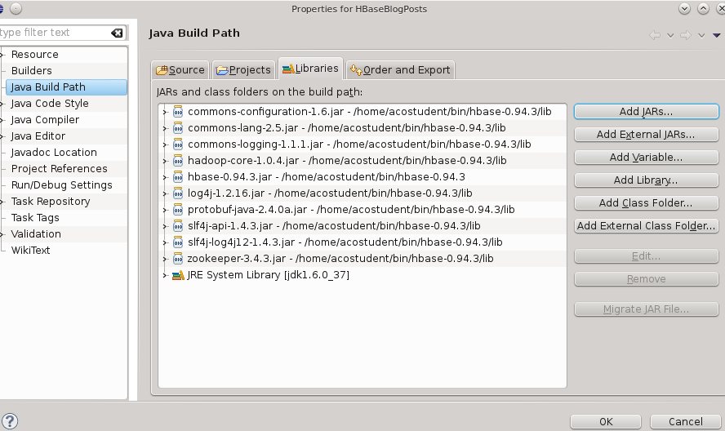
HBase: Accessing HBase from Java
Start HBase
Open Eclipse project HBaseBlogPosts
Already done in class VM
  Add required libraries (external JARs). They are found in:
  ~/bin/hbase-0.94.3/lib
  ~/bin/hbase-0.94.3
  Study the Java code, run it, and analyze its output

Slide 16
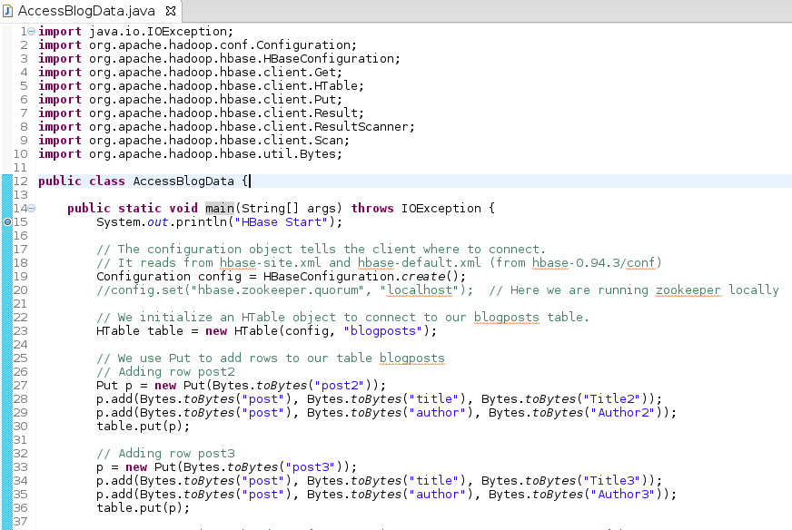
HBase: Accessing HBase from Java

Slide 17
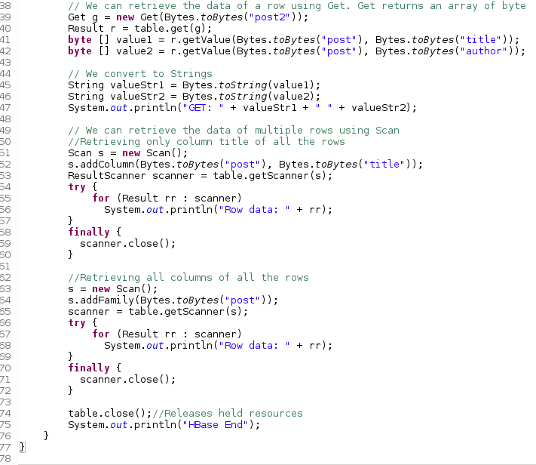
HBase: Accessing HBase from Java

Slide 18
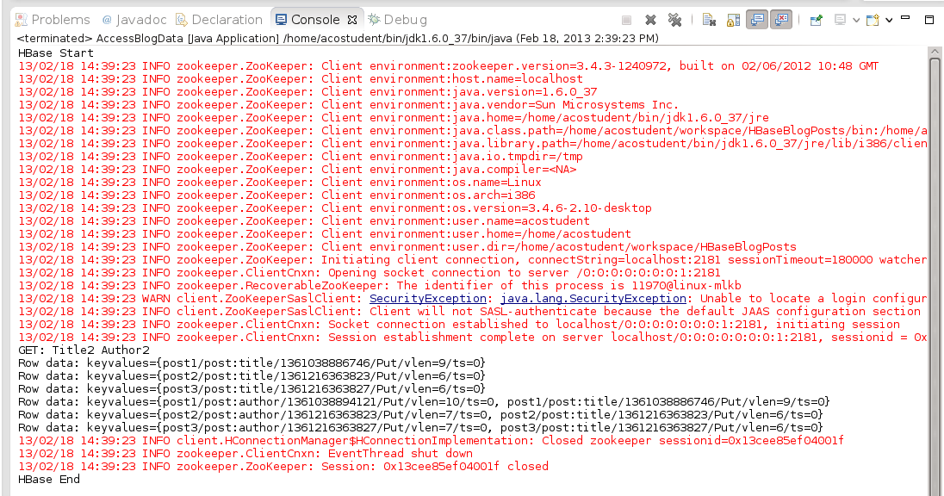
HBase: Accessing HBase from Java

Slide 19
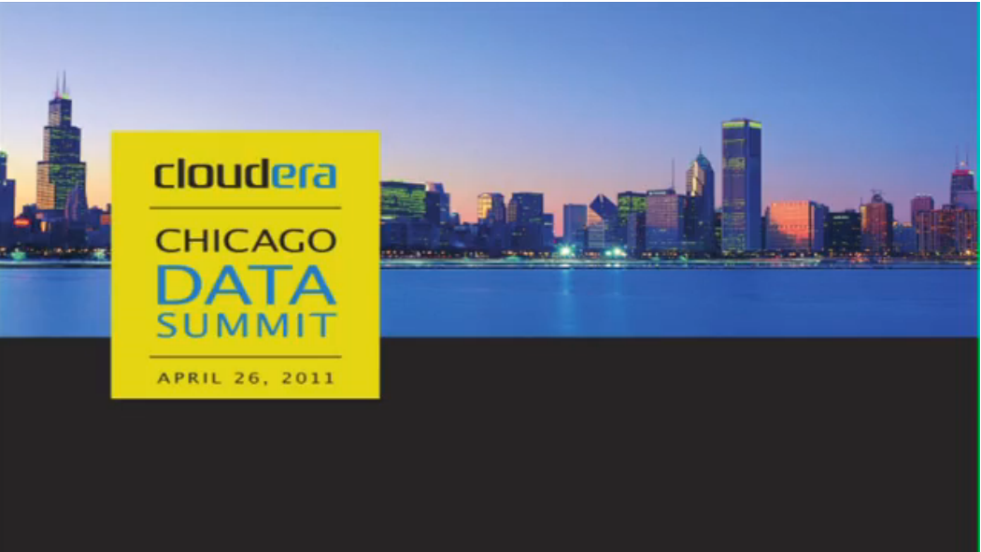
HBase: Video
http://vimeo.com/23400732

