Slide 1
NewSQL
Yasin N. Silva
Arizona State University
This work is licensed under a Creative Commons Attribution-NonCommercial-ShareAlike 4.0 International License. See http://creativecommons.org/licenses/by-nc-sa/4.0/ for details.

Slide 2
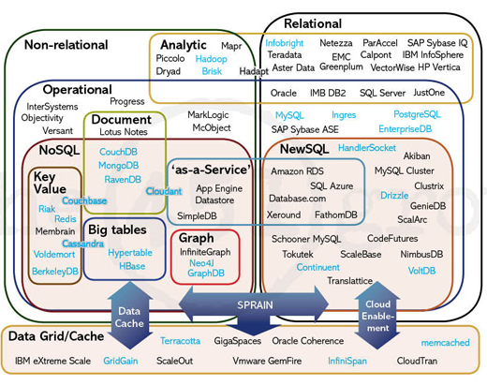
The Big Picture
http://blogs.the451group.com/opensource/2011/04/15/nosql-newsql-and-beyond-the-answer-to-sprained-relational-databases/

Slide 3
NewSQL
NewSQL is a class of database systems that aims to provide the same scalable performance of NoSQL systems while still maintaining the ACID guarantees of a traditional single-node database system.
When should you use NewSQL?
  When the application needs to handle very large datasets or a very large number of transactions
  When ACID guarantees are required
  When the application can significantly benefit from the use of the relational model and SQL
Related Article (Communications of the ACM)
  http://cacm.acm.org/blogs/blog-cacm/109710-new-sql-an-alternative-to-nosql-and-old-sql-for-new-oltp-apps/fulltext

Slide 4
NewSQL Database Features
Support the relational data model
Use SQL as the primary mechanism for application interaction
ACID support for transactions
A non-locking concurrency control mechanism so real-time reads will not conflict with writes, and thereby cause
them to stall
A scale-out, shared-nothing architecture, capable of running on a large number of nodes without bottlenecking
An architecture providing much higher per-node performance than available from traditional databases
Modified from http://cacm.acm.org/blogs/blog-cacm/109710-new-sql-an-alternative-to-nosql-and-old-sql-for-new-oltp-apps/fulltext

Slide 5
NewSQL Systems
New Architectures
  New database platforms designed to operate in a distributed cluster of shared-nothing nodes
  Examples: VoltDB, NuoDB, Clustrix, and VMware's SQLFire
MySQL Engines
  Highly optimized storage engines for MySQL.
  Use the same programming interface as MySQL but scale better
  Examples: TokuDB, MemSQL, and Akiban
Transparent Sharding
  These systems provide a sharding middleware layer to automatically split databases across multiple nodes
  Examples: dbShards, ScaleBase and ScaleDB
Modified from http://en.wikipedia.org/wiki/NewSQL

Slide 6
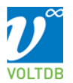
VoltDB
https://voltdb.com

Slide 7
VoltDB
In-memory database
ACID-compliant RDBMS
Uses a shared nothing architecture
Written in Java and C++
Supported operating systems: Linux and Mac OS X
Provides client libraries for Java, C++, C#, PHP, Python and Node.js

Slide 8
ACID in VoltDB
Atomicity
  VoltDB defines a transaction as a stored procedure, which either succeeds or rolls back on failure
Consistency
  VoltDB enforces schema and datatype constraints in all database queries
Isolation
  VoltDB transactions are globally ordered and run to completion on all affected partitions without interleaving
Durability
  VoltDB provides replication of partitions, and periodic database snapshots combined with command logging to ensure high availability and database durability
http://voltdb.com/dig-deeper/faq.php

Slide 9

VoltDB Video
http://vimeo.com/26680807

Slide 10
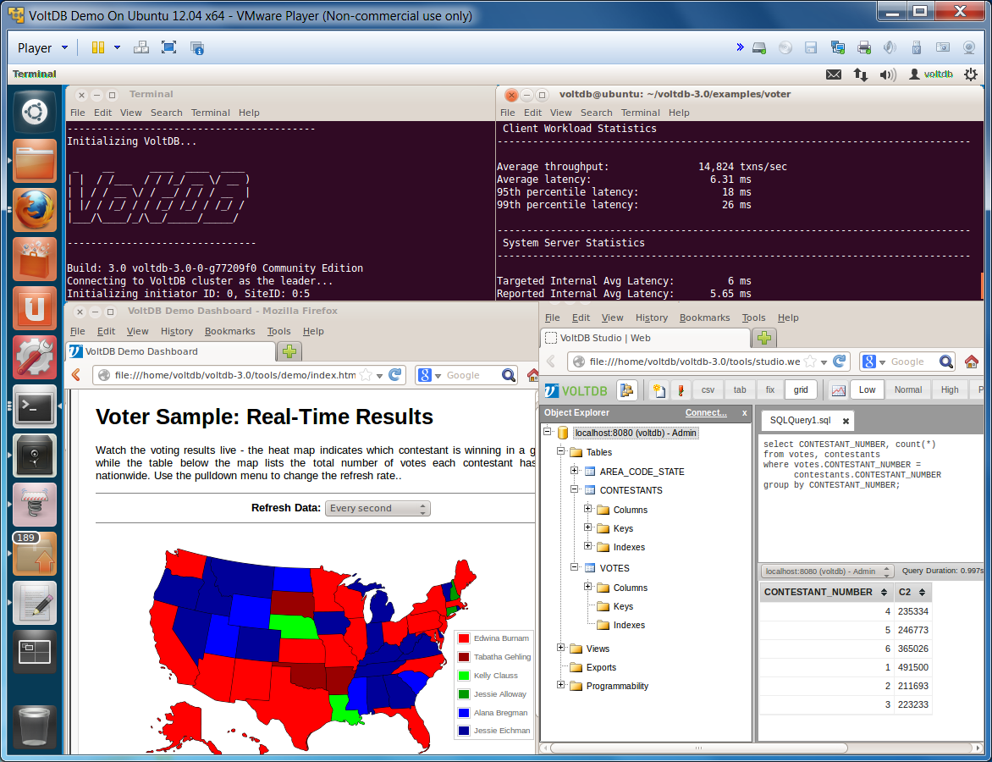
VoltDB VM

