Slide 1
Data Processing with MapReduce
Yasin N. Silva and Jason Reed
Arizona State University
This work is licensed under a Creative Commons Attribution-NonCommercial-ShareAlike 4.0 International License. See http://creativecommons.org/licenses/by-nc-sa/4.0/ for details.

Slide 2
MapReduce
Challenges in distributed processing/analysis
Extremely large data sets (petabytes of data)
Data is distributed across many systems (potentially thousands)
Individual systems are not aware of all data
Data is too large to be held or processed by any singular system
How to distribute and process a task that works over petabytes of data?

Slide 3
MapReduce
MapReduce was introduced as a programming model by Google in 2004*
Spreads the task of processing data out over many systems
Key-Value based system
Elements of divide and conquer
Makes use of the concept of hashing
Used for extremely parallel data processing/analysis
Highly scalable
Failure tolerant
* MapReduce: Simplified Data Processing on Large Clusters, OSDI’04: Sixth Symposium on Operating System Design and Implementation, San Francisco, CA, December, 2004

Slide 4
MapReduce
How does MapReduce work?
Three primary steps are used to run a MapReduce job
Map
Shuffle
Reduce
Data is read in a parallel fashion across many different nodes in a cluster (Map)
Groups are identified for processing the input data, then output
The data is then shuffled into these groups (Shuffle)
All data with a common group identifier (Key) is then sent to a single location
Each group is then processed atomically across the nodes in parallel. (Reduce)
Each node will receive one or more groups to process
Each group is then processed and the results of the union of each group is the result of the entire job.

Slide 5
MapReduce
A MapReduce (MR) program consists of generally two user defined stages.
Map:
Map(Key_{p}, Value_{p}) → list(Key_{i}, Value_{i})
Takes in a data element
Outputs Key-Value pairs
Reduce:
Reduce(Key_{i}, list(Value_{i})) → list(Value_{j})
Takes in a Key and a collection of Values
Outputs results

Slide 6
MapReduce
Diagram of a MapReduce Job Flow

Slide 7
MapReduce
Map Phase:
The map phase of MapReduce takes in a data element and divides it into zero or more output Key-Value pairs to be processed.
Each group to be processed in the Reduce is identified by the Key_{i} generated by the call to Map(Key_{p}, Value_{p})
Many different Map Tasks will be created across the different nodes in the distributed cluster
Each task will receive a block of the data to be processed
For each element in that block, it will make a call to Map(Key_{p}, Value_{p})
For each call of the Map(Key_{p}, Value_{p}) , it will emit a list of Key-Value pairs derived from the input element in the form list(Key_{i}, Value_{i})
All of the list(Key_{i}, Value_{i}) from the different Map Tasks and calls to Map will then be shuffled across the network to the different Reduce Tasks
This shuffling produces the <Key_{i}, list(Value_{i})> data collection that are the input to the Reduce Phase

Slide 8
MapReduce
Reduce Phase:
The reduce phase of MapReduce takes in a group defined by a unique key (Key_{i}) and a list of values (list(Value_{i}))
Many different reduce tasks will be created across the different nodes in the distributed cluster
Each task will make a call to Reduce(Key_{i}, list(Value_{i})) for every reduce group that it receives
Each call will process that reduce group atomically

Slide 9
MapReduce: Word Count
MapReduce Example Program: Word Count
Reads in files from the HDFS
Returns the counts of all words located in the files
Map:
Mapper (line_number, line_contents)
for each word in line_contents
emit(word, 1)
Reduce:
Reducer (word, values[])
sum = 0
for each value in values
sum = sum + value
emit(word, sum)

Slide 10
MapReduce: Word Count

Slide 11
Hadoop
What is Hadoop?
Hadoop Distributed File System (HDFS)
The file system is dynamically distributed across multiple computers
Allows for nodes to be added or removed easily
Highly scalable in a horizontal fashion
Hadoop Development Platform
Uses a MapReduce model for working with data
Users can program in Java, C++, and other languages

Slide 12
Hadoop
Some of the Key Characteristics of Hadoop:
On-demand Services
Rapid Elasticity
Need more capacity, just assign some more nodes
Scalable
Can add or remove nodes with little effort or reconfiguration
Resistant to Failure
Individual node failure does not disrupt the system
Uses off the shelf hardware

Slide 13
Hadoop
How does Hadoop work?
Runs on top of multiple commodity systems
A Hadoop cluster is composed of nodes
One Master Node
Many Client Nodes
Multiple nodes are used for storing data & processing data
System abstracts the underlying hardware to users/software

Slide 14
Hadoop: HDFS
HDFS is a multi-node system
Name Node (Master)
Single point of failure
Data Node (Client)
Failure tolerant (Data replication)
HDFS Consists of data blocks
Files are divided into data blocks
Default size if 64MB
Default replication of blocks is 3
Blocks are spread out over Data Nodes

Slide 15
Hadoop: Hadoop Stack
Hadoop Development Platform
User written code runs on system
System appears to user as a single entity
User does not need to worry about distributed system
Many system can run on top of Hadoop
Allows further abstraction from system

Slide 16
Hadoop: Hive & HBase
Hive and HBase are layers on top of Hadoop
HBase & Hive are applications
Provide an interface to data on the HDFS
Other programs or applications may use Hive or HBase as an intermediate layer

Slide 17
Hadoop: Hive
Hive
Data warehousing application
SQL like commands (HiveQL)
Not a traditional relational database
Scales horizontally with ease
Supports massive amounts of data*
* Facebook has more than 15PB of information stored in it and imports 60TB each day (as of 2010)

Slide 18
Hadoop: HBase
HBase
No SQL Like language
Uses custom Java API for working with data
Modeled after Google’s BigTable
Random read/write operations allowed
Multiple concurrent read/write operations allowed

Slide 19
Hadoop MapReduce
Hadoop has it’s own implementation of MapReduce
Hadoop 1.0.4
API: http://hadoop.apache.org/docs/r1.0.4/api/
Tutorial: http://hadoop.apache.org/docs/r1.0.4/mapred_tutorial.html
Custom Serialization
Data Types
Writable/Comparable
Text vs String
LongWritable vs long
IntWritable vs int
DoubleWritable vs double

Slide 20
Structure of a Hadoop Mapper (WordCount)

Slide 21
Structure of a Hadoop Reducer (WordCount)

Slide 22
Hadoop MapReduce
Working with the Hadoop
http://hadoop.apache.org/docs/r1.0.4/commands_manual.html
A quick overview of Hadoop commands
bin/start-all.sh
bin/stop-all.sh
bin/hadoop fs –put localSourcePath hdfsDestinationPath
bin/hadoop fs –get hdfsSourcePath localDestinationPath
bin/hadoop fs –rmr folderToDelete
bin/hadoop job –kill job_id
Running a Hadoop MR Program
bin/hadoop jar jarFileName.jar programToRun parm1 parm2…

Slide 23
Hadoop MapReduce
Lab Session

Slide 24
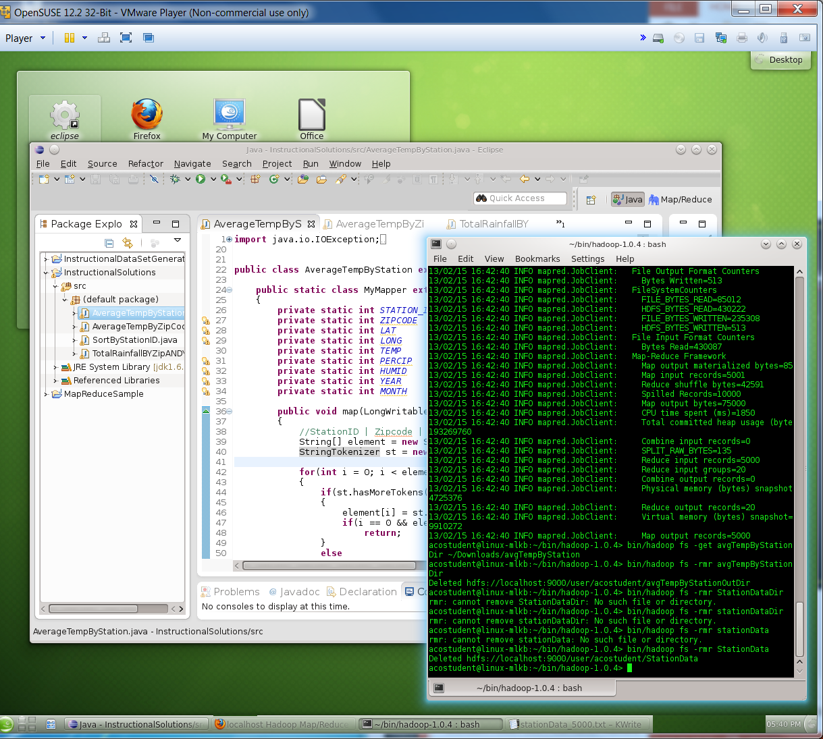
Hadoop MapReduce
We will use a Virtual Machine where Hadoop has been installed and configured
VMWare Player
OpenSUSE Linux
User Name: acostudent
Password: acohadoop
Hadoop 1.0.4 using pseudo-distributed mode
Initial Steps
Install VMWare Player if needed
Get a copy of the VM
To restart Hadoop you may need to (Hadoop is already stated in the VM):
Re-start OpenSUSE
Delete the /tmp/hadoop-acostudent folder
Reformat HDFS: bin/hadoop namenode -format (from ~/bin/hadoop-1.0.4/)
bin/start-all.sh (from ~/bin/hadoop-1.0.4/)
If eclipse doesn’t open, follow the steps in the notes of this slide.
Notes:
Some students may not be able to open eclipse if the VM had to be restarted the first time it was opened. The re-start procedure does not gracefully close some files used by eclipse. The solution is to create a new workspace for eclipse and reconfigure eclipse. This process only needs to be done once.
1. Rename the folder workspace (/home/acostudent/workspace) to workspace2 (/home/acostudent/workspace2)
2. Create a workspace folder (/home/acostudent/workspace)
3. Open eclipse
4. Change workspace in eclipse (File->Switch_Worspace->Select_File), select the /home/acostudent/workspace folder.
5. Import the java projects in eclipse (File->Import->General->Existing_Projects_into_Workspace) and select /home/acostudent/workspace2 in the field “Select root directory”. Check the option “Copy projects into workspace” and then finish.
6. Configure Eclipse to work with Hadoop:
Go to Window > Preferences
Select "Java > Installed JREs" on left side
Click on "Add.."
Choose "Standard VM"
Click Next
Set the JRE Home:
browse to the root directory of the Java 6 jdk that was downloaded
"/home/acostudent/bin/jdk1.6.0_37"
Click Finish
Check the box next to jdk1.6.0_37 (or current distribution)
Select "Hadoop Map/Reduce" on left side
Set the Hadoop installation directory
click on Browse and navigate to "/home/acostudent/bin/hadoop-1.0.4/"
click ok
click Apply
Select "Java > Compiler" on left side
Set "Compiler compliance level" to 1.6
click Apply
Click "Ok"
Close Eclipse and re-launch it

Slide 25
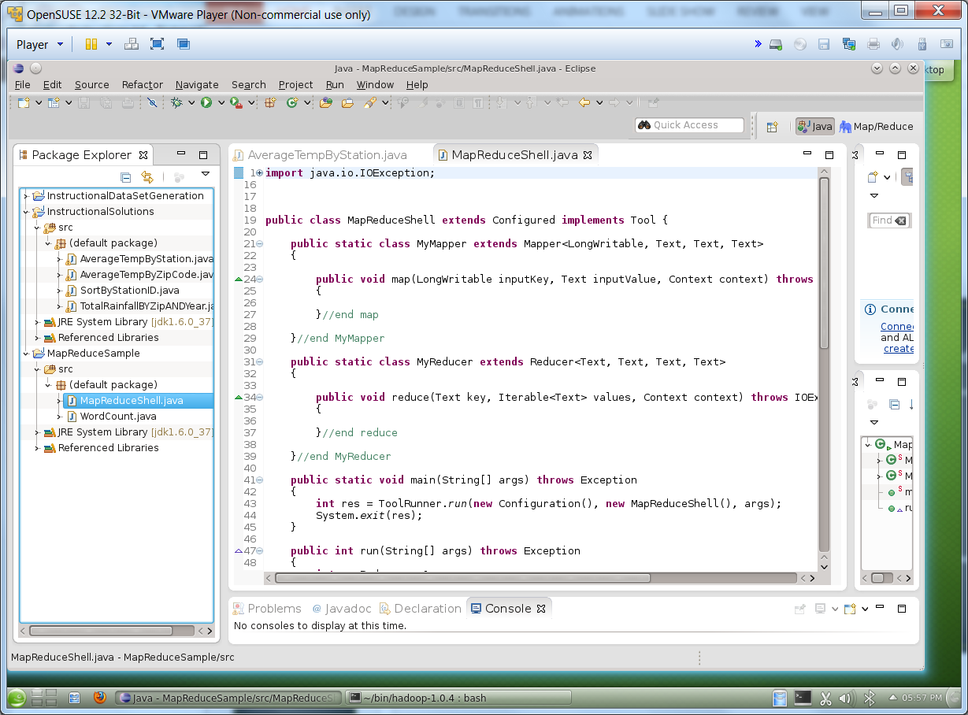
MapReduceShell
Main directories
~/Documents: contains input data files
~/Downloads: we will save the output of our programs in this directory
~/bin/hadoop-1.0.4/: Main Hadoop directory
~/workspace: Eclipse workspace with MapReduce code
Review in detail the following MapReduce program
MapReduceShell.java
This is a shell of a MapReduce program

Slide 26
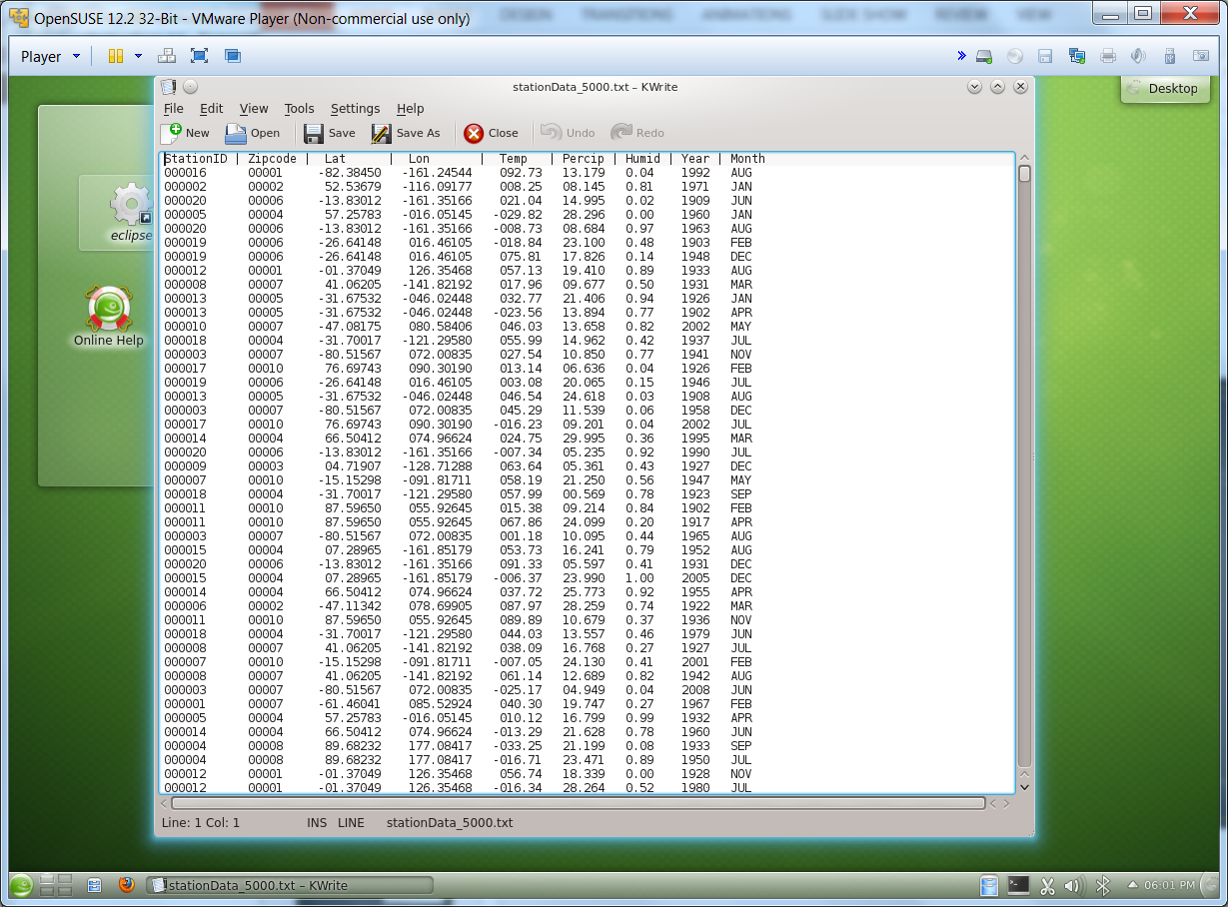
Meteorological Station Data
We will use this dataset in several MapReduce examples
Each record contains:
StationID
Zipcode
Lat
Lon
Temp
Percip
Humid
Year
Month
Review the MapReduce programs that process this dataset
AverageTemperatureByStation.java
AverageTempByZipCode.java
SortByStationID.java

Slide 27
Important Hadoop commands
cd ~/bin/hadoop-1.0.4/
Starting Hadoop (already stated in the VM):
Usage: bin/start-all.sh
It may take a moment for the system to fully start. Can take up to 5 min some times, the best way to check that it is fully up is to look at the Job Tracker page:
http://localhost:50030/jobtracker.jsp
In pseudo-distributed mode, it should read that 1 node is available (sometimes this value is only updated after copying data to the HDFS).
Shutting down Hadoop:
Usage: bin/stop-all.sh
Can be useful to restart Hadoop if you are having issues with the HDFS not coming out of Safe Mode or the Nodes not starting correctly

Slide 28
Important Hadoop commands
Loading Data to the HDFS:
Usage: bin/hadoop fs -put <local source directory> <destination directory in HDFS>
Sample: bin/hadoop fs -put ~/Documents/DataFiles/StationData stationDataDir
Getting Data out of the HDFS:
Usage: bin/hadoop fs -get <source directory in HDFS> <local destination path>
Sample: bin/hadoop fs -get stationDataDir ~/Downloads/stationData
Deleting information in the HDFS:
Usage: bin/hadoop fs -rmr <HDFS file or directory to delete>
Sample: bin/hadoop fs -rmr stationDataDir

Slide 29
Running MapReduce programs
Running the program to compute the Average Temp By StationID (using 2 reducers)
Usage: bin/hadoop jar InstructionalSolutions.jar AverageTempByStation <input directory> <ouput directory> <number of reduces>
Sample: bin/hadoop jar InstructionalSolutions.jar AverageTempByStation stationDataDir avgTempbyStationOutDir 2
Copying the data from HDFS to local directory:
bin/hadoop fs -get avgTempbyStationOutDir ~/Downloads/avgTempbyStationOutDir

Slide 30
Running MapReduce programs
Study and run the following MapReduce programs
AverageTempByZipCode.java
SortByStationID.java
WordCount.java
Solution of the word count problem

